Slide 1
Geographic Data with R
Andrew McLean
andrew.mclean@ed.ac.uk

Slide 2
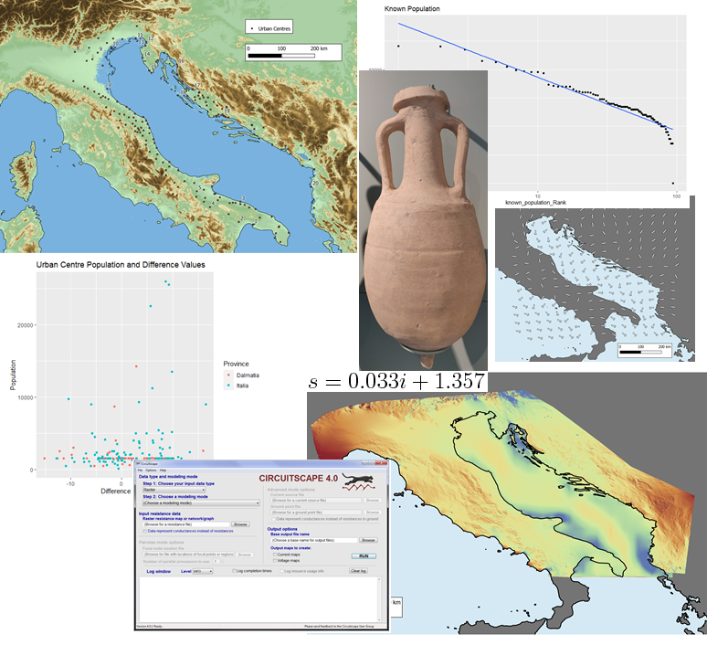

Before Starting…
Who am I
PhD candidate in Classics/Archaeology at the University of Edinburgh
Training Fellow with DCS

Slide 3
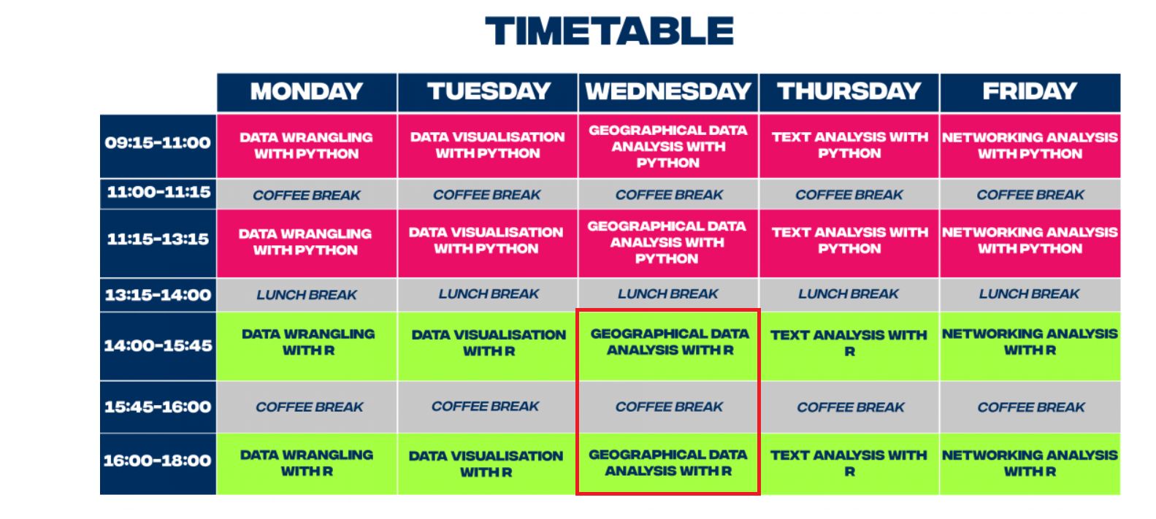
Before Starting…
The class
Two parts
Basic introduction to geographic data
Manipulating and visualising simple geographic data in R
(some more detailed visualisations if we have time)

Slide 4
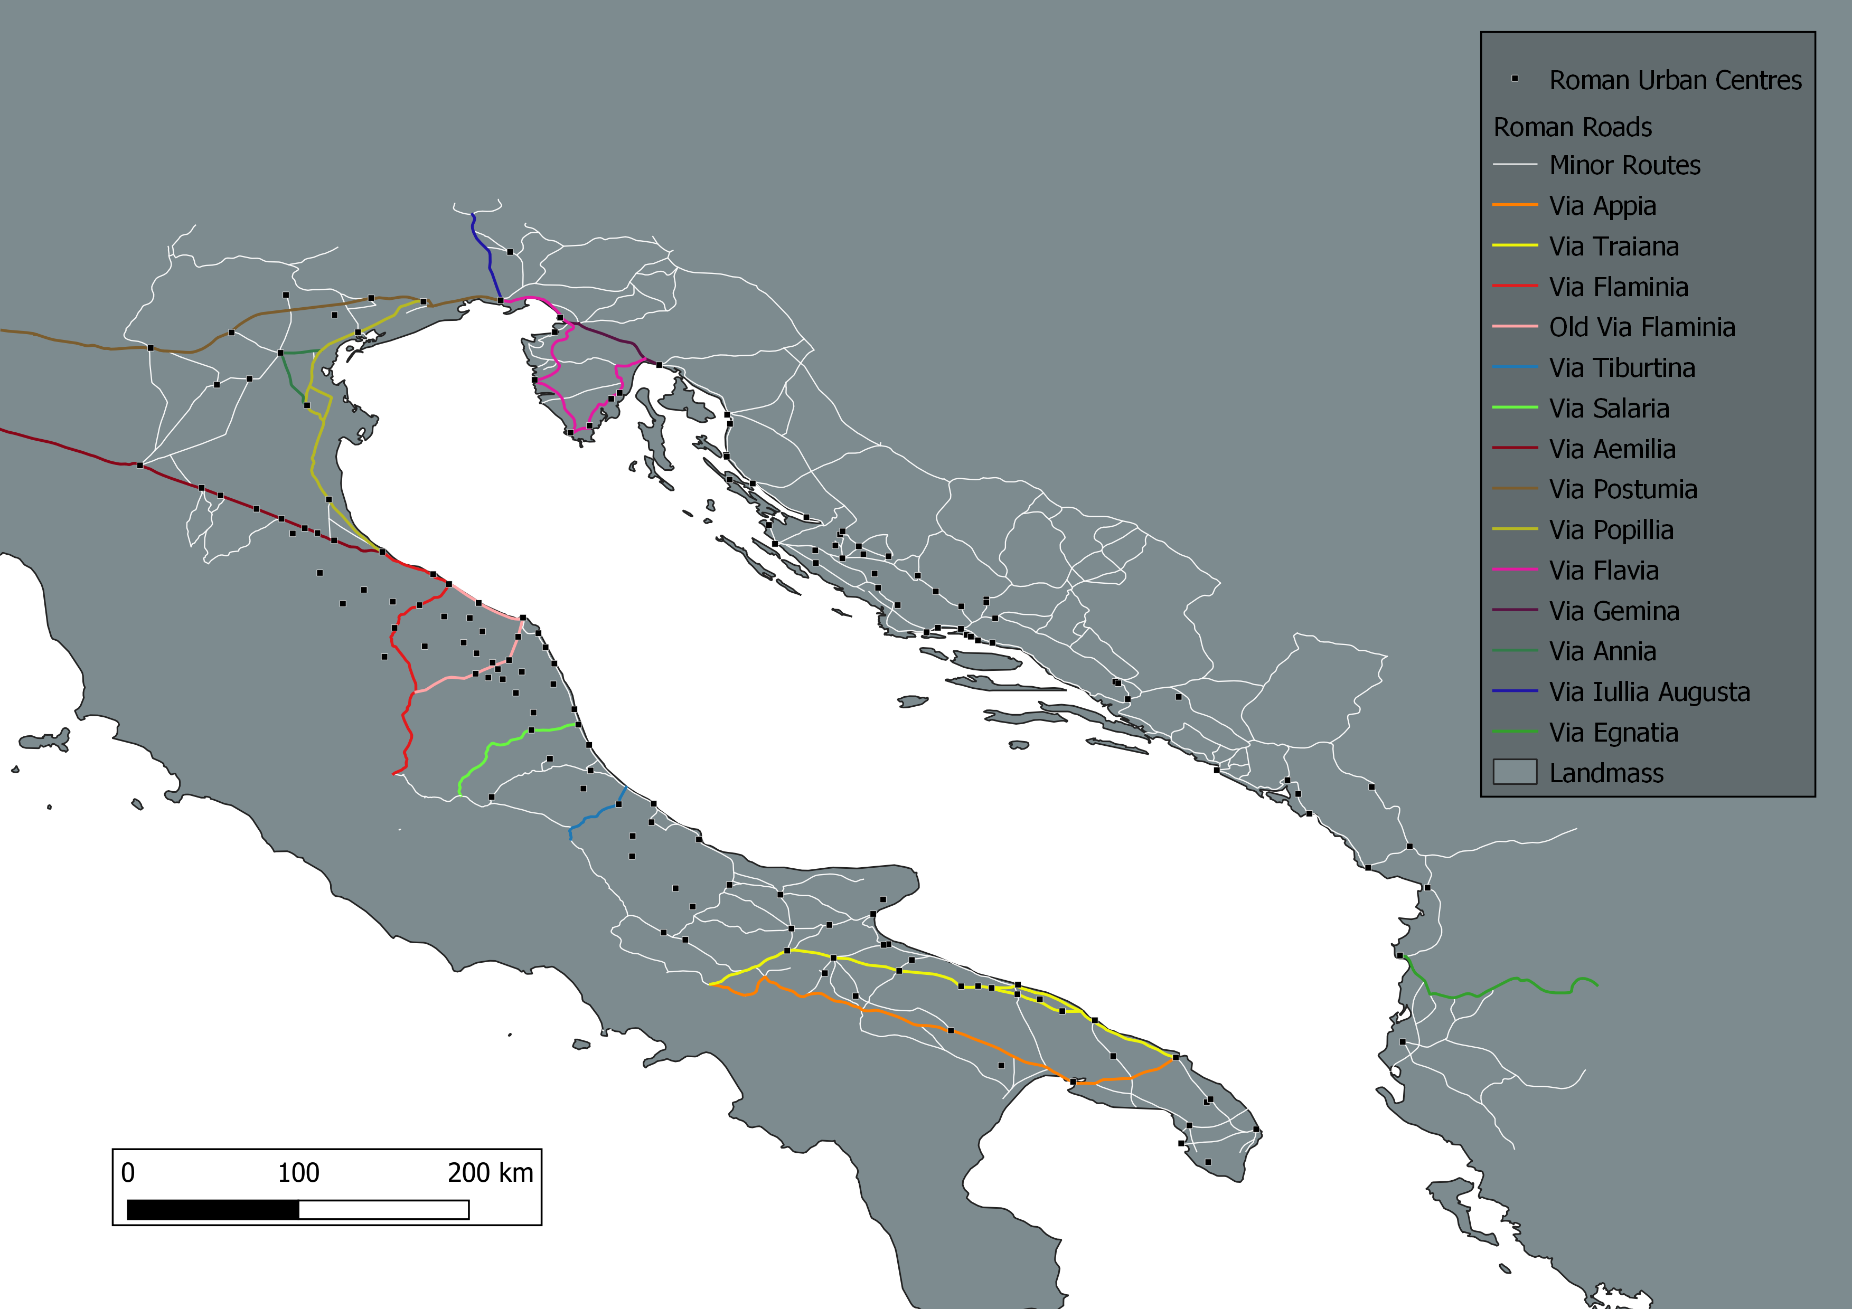
What is Geographic Data? Vectors
Generalised representation of the real world
Points, lines or polygons
Normally in .shp (shapefile) format
https://www.safe.com/what-is/spatial-data/

Slide 5
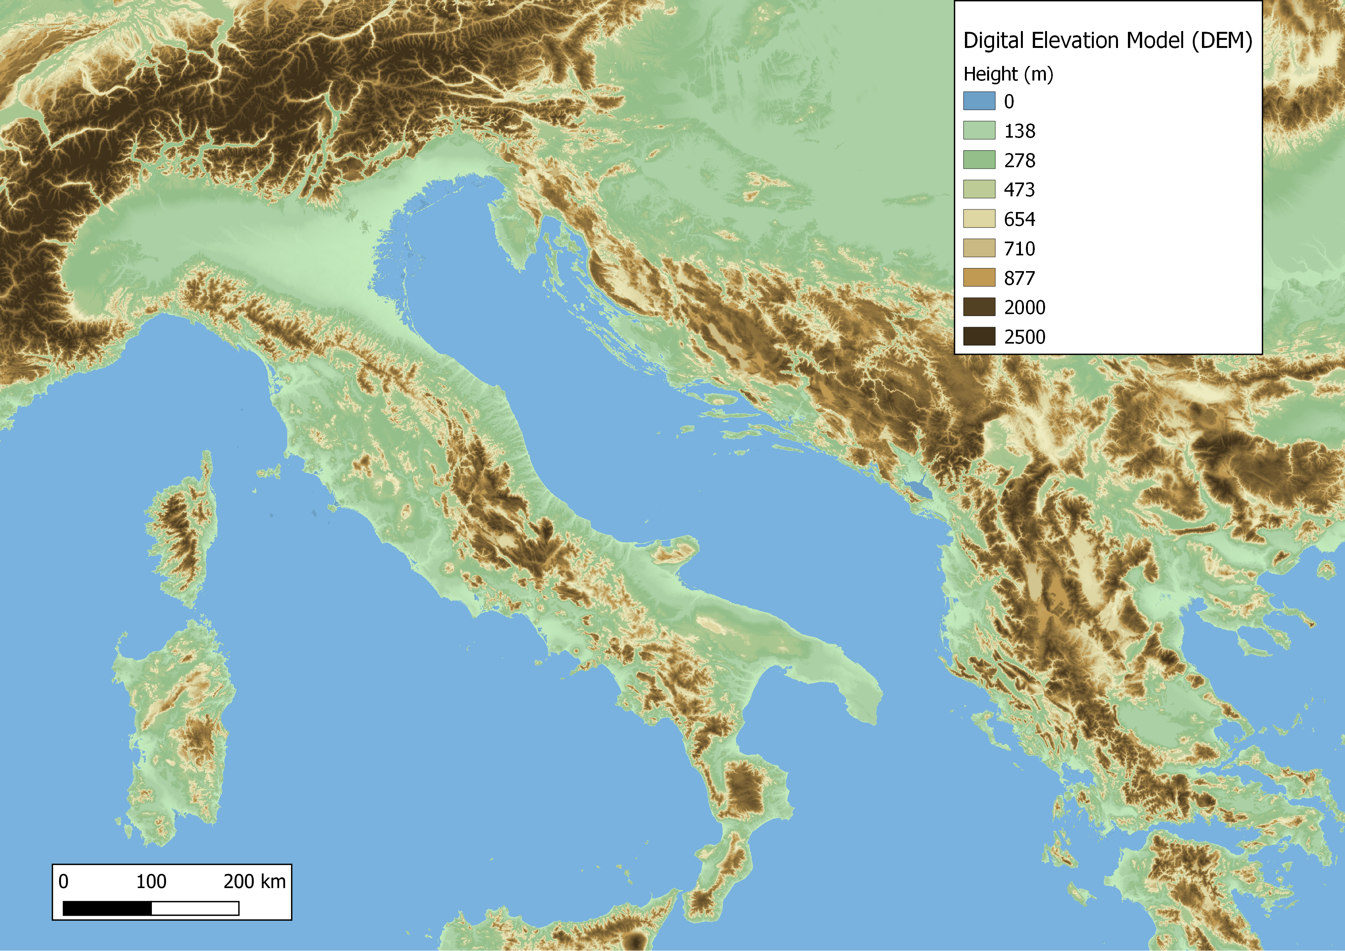
What is Geographic Data? Rasters
Grid of pixels, each with a value
Quality depends on resolution of pixels
Various formats, normally .tif
https://www.safe.com/what-is/spatial-data/

Slide 6
What is Geographic Data? Attributes
Any non-spatial information that describes a feature
https://www.safe.com/what-is/spatial-data/

Slide 7
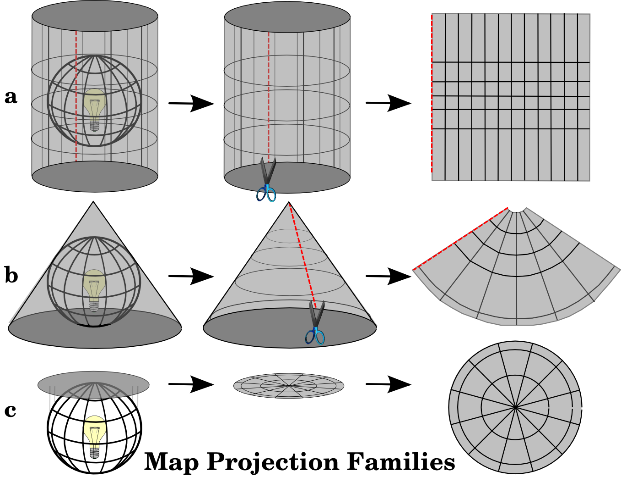
What is Geographic Data? Projections and Coordinate Reference Systems (CRS)
Maps, whether physical or digital, generally portray a three dimensional space (the planet) on a 2 dimensional medium
CRS are the systems that, with the use of coordinates, define how the 3D data is projected onto the 2D output
https://docs.qgis.org/3.16/en/docs/gentle_gis_introduction/coordinate_reference_systems.html

Slide 8
What is Geographic Data? Projections
There are three main map projection families
A) cylindrical
B) Conical
C)Planar
Each has advantages and disadvantages
None actually change the data itself, simply the way it is presented/projected
https://docs.qgis.org/3.16/en/docs/gentle_gis_introduction/coordinate_reference_systems.html

Slide 9
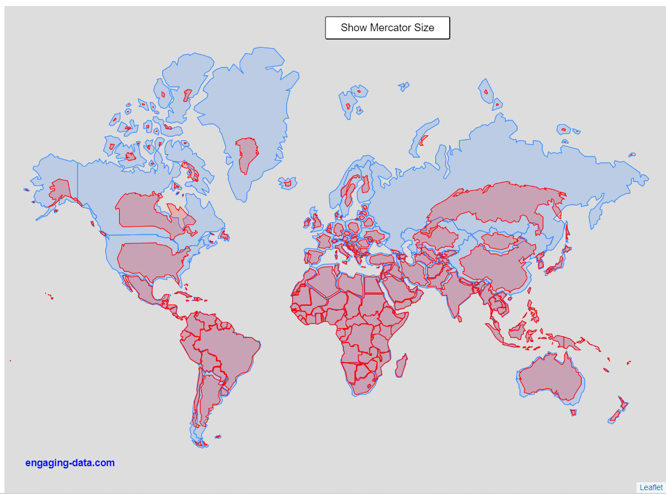
What is Geographic Data? Projections
A common projection is Mercator
No projections are entirely accurate, they are representations of reality, not reality itself
https://engaging-data.com/country-sizes-mercator/
https://thetruesize.com/#/aboutModal?borders=1~!MTU0MzY5MjU.NTEzMTkzNw*MzIyNDYwNjQ(NTI0NjA2NA

Slide 10
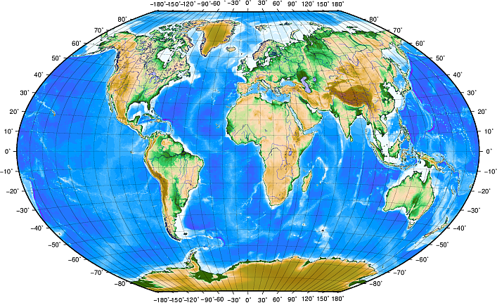
What is Geographic Data? Coordinate Reference Systems (CRS)
CRS can be divided into two main categories: projected and geographic
Geographic use longitude and latitude (WGS 84 is a common geographic CRS)
https://docs.qgis.org/3.16/en/docs/gentle_gis_introduction/coordinate_reference_systems.html

Slide 11
What is Geographic Data? Coordinate Reference Systems (CRS)
CRS can be divided into two main categories: projected and geographic
Projected use x and y coordinates, and occasionally z for 3 dimensional data
https://www.earthdatascience.org/courses/use-data-open-source-python/intro-vector-data-python/spatial-data-vector-shapefiles/geographic-vs-projected-coordinate-reference-systems-python/

Slide 12
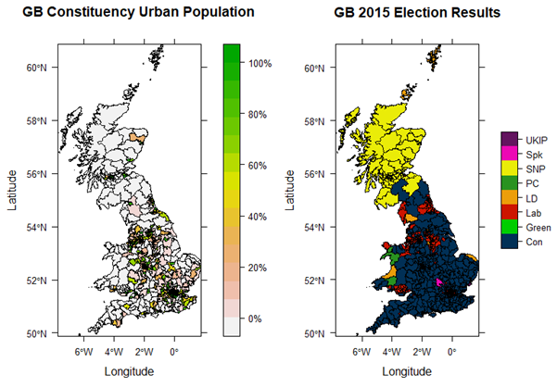
Geographic Data in R
You won’t need to worry too much about vectors, rasters and CRS in this class
We will mainly be working with vectors and sticking to standard CRS
It is important to understand some of the differences and issues involved

Slide 13
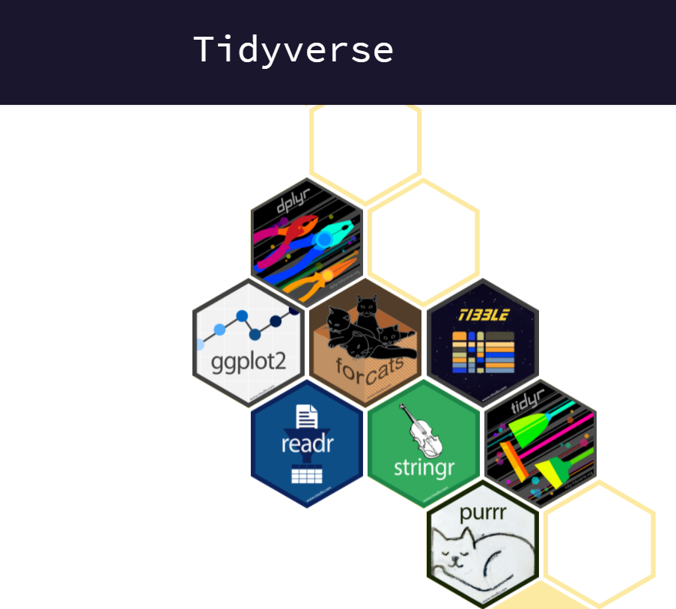
Geographic Data in R
Packages
The main package we will be using is sp
Additional packages that should be installed:
tidyverse
rgdal
sf
raster
terra
latticeExtra

